Slide 1
PREDICTING SONG GENRES
Supervised learning

Slide 2
OVERVIEW
Purpose
Predict song genres to help categorize songs and make personalized recommendations to users
Stakeholders
Customers and Song Streaming Service Providers such as Youtube Music, Spotify, Soundcloud, etc.
Process
Utilizing Machine Learning algorithms to predict song genres based on raw numerical and categorical track data

Slide 3
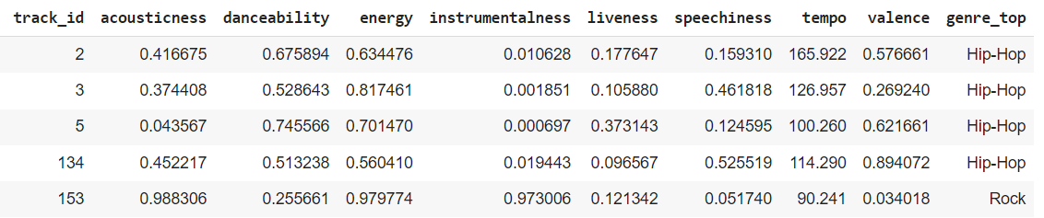
DATA
Our dataset was sourced by a research group known as The Echo Nest. The group researched over 10,000 songs to rate a variety of metrics
The dataset contained 8 features – 7 numeric and 1 categorical
There was no missing data and since almost all data was numerical (float64 type) we didn’t have to perform any data cleaning. This was very lucky for us although such instances are very rare in the world

Slide 4
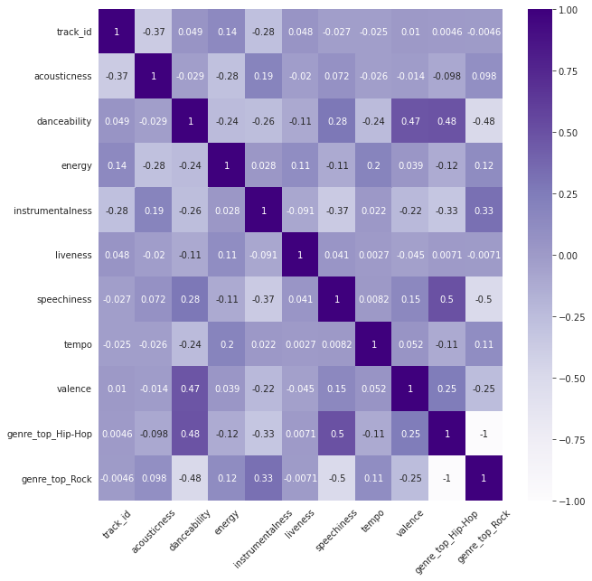
FEATURES
Energy
Acousticness
Danceability
Liveness
Speechiness
Tempo
We see that Hip-Hop songs have the most speech and danceability
Rock songs on the other hand have more instruments involved
Valence
Instrumentalness
Genre

Slide 5
EXPLORATORY DATA ANALYSIS
Rock songs have more Acousticness, i.e., less electrical elements to the characteristics of the sound/music.
Rock songs have more Energy, i.e., a higher level of intensity of music.
Hip-Hop and Rock both have a similar level of Liveness, i.e., a similar ambience to the kind of music each uses.
Hip-Hop songs have more Danceability about them.
As stated, Rock songs have a higher level of instrumental use.
Hip-Hop songs on the other hand have more lyrics involved which is obvious as Rap is all about telling a song story through words. (There are plenty of outliers for each still)
Both have almost similar levels of tempo, although Hip-Hop songs tend to have a higher range of variance about the beats-per-second employed.
Hip-Hop songs have higher valence, i.e., they tend to be more positive than Rock songs. The latter can have mostly melancholy tones attached to them, though this is ofcourse an assumption.

Slide 6
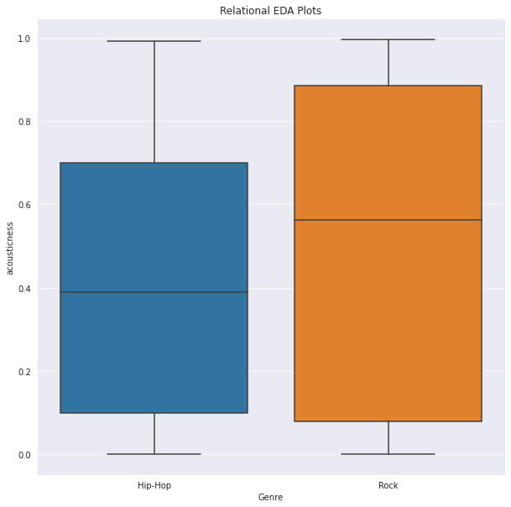
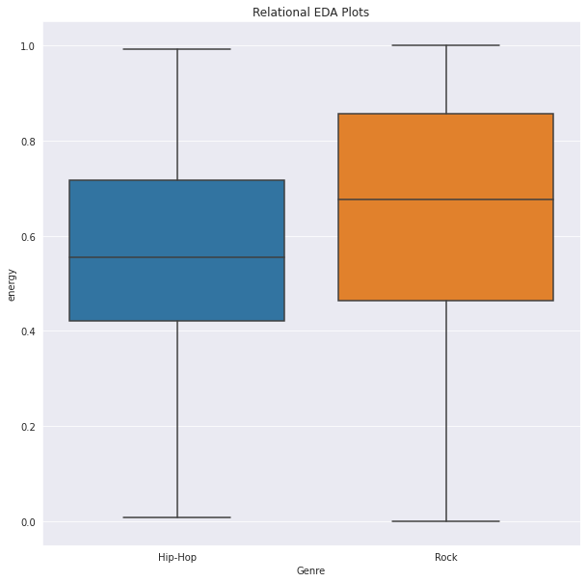
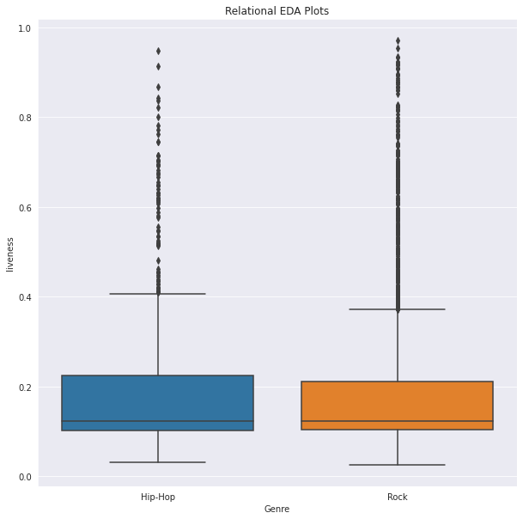
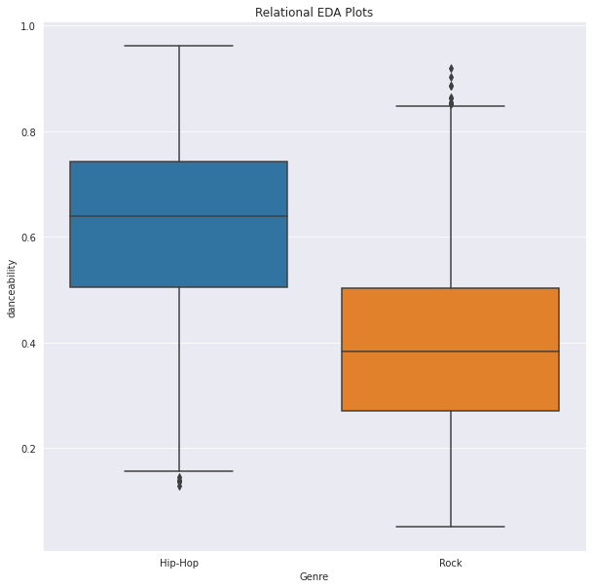

Slide 7
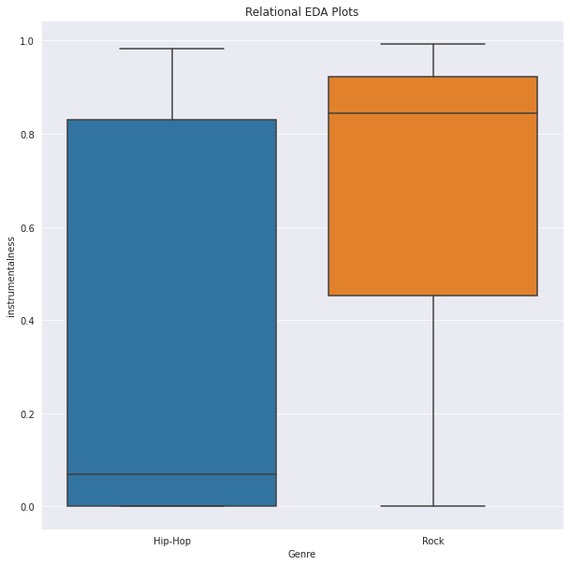
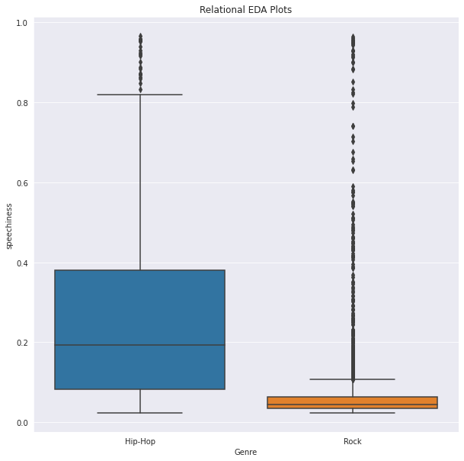
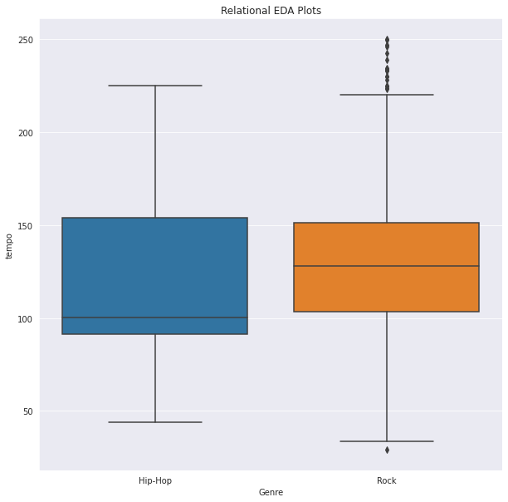
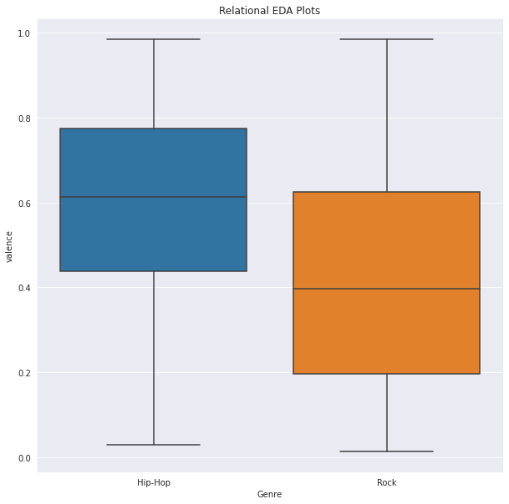

Slide 8
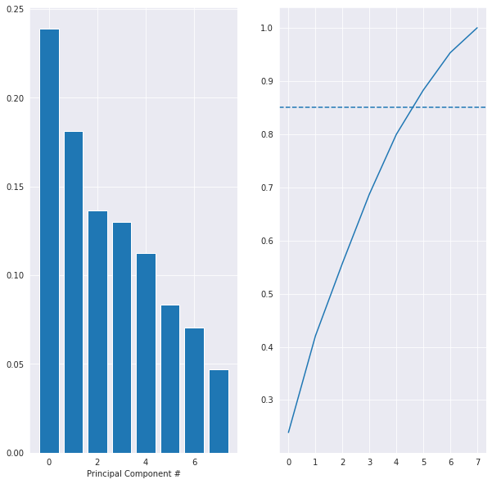
FEATURE SELECTION
We employed Principal Component Analysis (PCA) to reduce the dimensionality of our dataset.
We dropped the Track ID feature as it was just adding random noise to the dataset.
The PCA showed us that a linear combination of 6 principal components (features) could explain the variance in the target variable.
The bar plot shows the explained variance of individual components whereas the line chart shows cumulative explained variance.

Slide 9
MODEL EVALUATION
We made use of two classifiers, namely – Logistic Regression and Decision Tree Classifier.
We made use of pipelines to scale, apply PCA, and cross-validate both models over the training dataset split 5 times.
The classification report showed us that even though the selected Logistic Regression model does well in predicting rock songs, there is a high number of False Negatives for Hip-Hop songs.
To fix for such an error, we re-evaluated the chosen model by sampling equal proportion of occurrences of each song genre from the training set.
The number of False Negatives went down for Hip-Hop songs but so did the accuracy of the model as a trade-off.

Slide 10
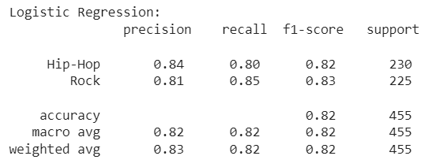
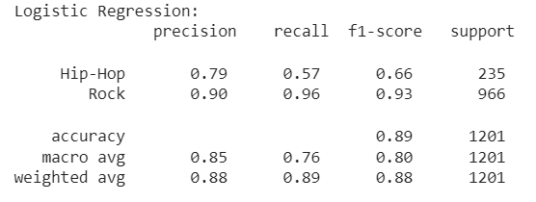
EVALUATION METRICS
Logistic Regression CV Score = 0.8660624566874567
Decision Tree CV Score = 0.8442182085932085
Pre-Sampling Matrix
Post-Sampling Matrix

Slide 11
FURTHER STEPS
Next steps would be to build on the model by incorporating other types of song genres and finding insights about those.
The models can themselves still be improved upon by including polynomial parameters and/or incorporating more features for which data was not available, such as – Artist, Popularity, etc.
Could also make use of GridSearchCV or RandmoizedSearchCV to select the right hyperparameters instead of tuning them by hand or using default values.

